Slide 1

Notes:
1st slide (Mandatory)

Slide 2
CIRCULAR & MULTI SHAPE ARRANGEMENT

Slide 3
QUESTION 1
Eight friends K,L,M,N,O,P,Q, and R are sitting anticlockwise around a circular table facing the center in the same sequence with equal distances between them.
If M is sitting in the southwest direction, then in which direction is P sitting.
North west
South east
South
east
Notes:
Answer: d

Slide 4
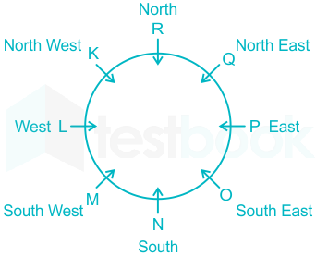

Slide 5
QUESTION 2
Eight persons K, H, T, E, D, W, Q and S are sitting in a square table. Four persons sit at corner and four persons sit at middle side of the table. Person those sitting at corner faces the centre and Person those sitting at middle side of the table faces away from the centre.
Three persons sit between K and H. As many persons sit between H and D sits between D and K. Q sits immediate left of D. Q and K are not immediate neighbours. As many persons sit between T and W sits between W and S. W does not faces away from the centre. H and S are not immediate neighbours. Q does not sit opposite to S

Slide 6
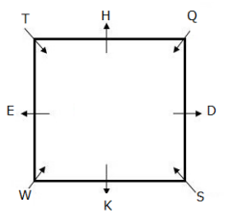
Which of the following statement is true?
a) E sits third to the right of S
b) W sits opposite to D
c) As many persons sit between Q and H sits between D and S
d) Only one person sits between T and S
e) None is true
Notes:
ans: c

Slide 7
2) If all the persons are made to sit alphabetically from D in clockwise direction, then how many persons remain unchanged?
None
One
Two
Three
e) None of these
3) Which of the following person sits fifth to the left of S?
a) Q
b) The one who is Immediate left of T
c) The one who is Immediate left of Q
d) The one who is Second to the right of D
e) None of these
Notes:
ans: a & b

Slide 8
QUESTION 3
There are nine persons P, Q, R, S, T, U, V, W and X sitting on the corners of two different polygons of which one is square and other is pentagon. Both the polygon is concentric such that Square is inside the pentagon.
All the persons are facing inside the polygon. S is sitting third to the right of X. X is exactly ahead or behind of R. W is sitting third to the left of R. T is the immediate neighbour of R. P is not the immediate neighbour of U. V sits on the immediate left of Q. U is neither the immediate neighbour of T nor X.

Slide 9
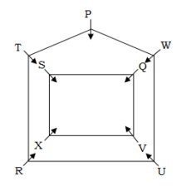
1) Who among the following sits second to the right of U after arrangement?
(a) Q
(b) R
(c) P
(d) T
(e) V
2) How many persons are sitting between R and W in final arrangement when counted to the right of W.
(a) 1
(b) 4
(c) 3
(d) 2
(e) 5
Notes:
Answer : c
Answer : d

Slide 10
QUESTION 4
Eight persons A, B, C, D, E, F, G, H are sitting around a hollow circular table such that four of them sit on the inner side of the table and face away from the center and the rest are sitting on the outer side circle and face towards the center. The persons sitting on the outer side circle are facing the persons sitting on the inner side of the table. They like either a fruit or a color. Person on the same side of the table likes same element.
C is not neighbor of G, who likes green. B faces A, who likes blue.
The one who likes mango faces the one who likes yellow. A sits 2nd to the left of the one who faces F. One of the eight persons likes litchi. D does not face G.
The one who likes guava faces the one who is 2nd to the left of E, who likes Red. H is not immediate left of B. F does not like papaya. H is not facing away from the center. C does not like any fruit.

Slide 11
1) Four of the following five belongs to a group find the one that does not belong to that group?
A) F-red
B) H-green
C) A-Guava
D) C-mango
E) D-papaya
2) Who among the following faces the one who sit immediate left to the one who likes litchi?
A) F
B) H
C) B
D) C
E) None of these
Notes:
1) Ans(E)
2) Ans(E)

Slide 12
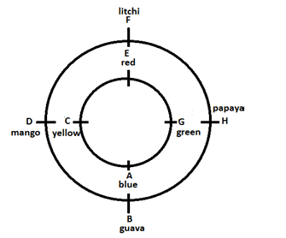

Slide 13
QUESTION 5
Direction: Study the following information carefully and answer the questions.
Eight colleagues- A, B, C, D, E, F, G, and H are sitting around a circular table facing the center but not necessarily in the same order. Each one of them hold a different post - Manager, Company - Secretary, Chairman, President, Vice-President, Group-Leader, Financial Adviser and Managing Director.
A sits third to the right of Managing Director. Only two people sits between the Managing Director and H.
The Vice- President and the Company Secretary are immediate neighbors.
Neither A nor H is a Vice- President or a Company Secretary. The Vice- President is not an immediate neighbors of the Managing Director.
The Manager sits second to the left of E. E is not an immediate neighbor of H. The Manager is an immediate neighbor of both the Group- leader and the Financial Adviser.
The Financial Adviser sits third to the right of B. B is not the Vice- President.
C sits on the immediate right of the Chairman. A is not the chairman. F is not an immediate neighbor of A.
G is not an immediate neighbor of the Manager.

Slide 14
1Q.Which of the following is true with respect to the given seating arrangement?
A) The Group Leader of the Company is an immediate neighbour of the Vice President.
B) G sits second to the right of D.
C) The Group leader and the company secretary are immediate neighbors.
D) The Chairman of the company sits to the immediate left of Managing Director.
E) The Group Leader sits second to the left of D
2Q.Who among the following sits exactly between Managing Director and H?
A) H and the Chairman
B) B and G
C) The Chairman and C
D) F and C
E) E and the Group Leader
Notes:
ANS: D, E

Slide 15
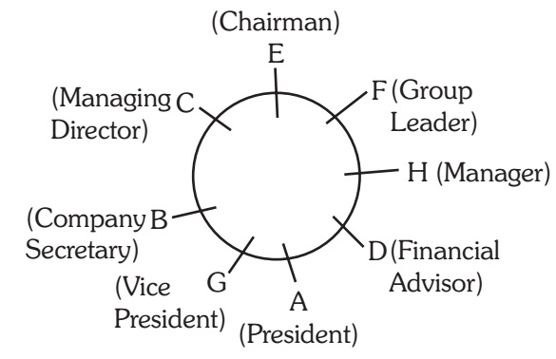

Slide 16
QUESTION 6
Seven employees Shaikh, Tej, Vijay, Jai, Ambani, Mala and Boss are sitting in a circle and facing the centre. Jai is sitting three placed right of Boss who is sitting one place right of Shaikh. Vijay forms an angle of 90 degree from Ambani and an angle of 120 degree from Mala. Mala is just opposite to Tej and is sitting just on the left of Ambani. Only Jai is between Vijay and Ambani.
Notes:
Ans: e
Ans: b

Slide 17
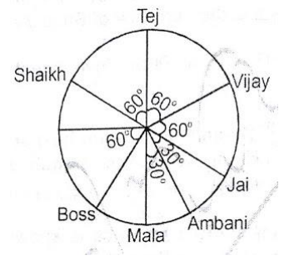
1) Which of the following statement is not correct?
Mala is between Tej and Shaikh
b) Vijay is between Jai and Mala
c) Shaikh is between Boss and Mala
d) Boss is between Mala and Ambani
e) All of the above
2) What is the position of Shaikh with respect to Vijay?
a) Third to the right
b) Second to the right
c) Second to the left
d) Third to the left
e) None of these
Notes:
5)-e

Slide 18
QUESTION 7
Eight friends D, E, F, G, H, I, J and K are sitting around a circular table at equal distance between each other, but not necessarily in the same order. All friends are facing the centre. D sits either second to the left of G or second to the right of I and there is an angle between D and J, which is 180° at the centre. K is third to the left of J. F is third to the right of E. There is an angle between I and G which is 135° at the centre. F is not an immediate neighbor of either D or G. There is an angle between H and I which is 45°.

Slide 19
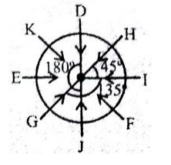
Q1) If K and F interchange their positions, who will sit on the immediate right of F?
a) E
b) J
c) I
d) G
e) None of these
Q2).What is the measurement of the angle made between D and H?
180°
90°
135°
45°
None of these
Notes:
1) Answer: a)
2). Answer: d)

Slide 20
QUESTION 8
Eight friends-Romil, Ramesh, Rakesh, Rohit, Rahul, Abhijeet, Abhishek and Anil- are sitting around a circular table, but not necessarily in the same order, Four of them are facing inside and the other four are facing outside. All eight friends belong to eight different cities-Bhopal, Patna, Kolkata, Delhi, Gwalior, Bengaluru, Chennai and Rajkot-but not necessarily in the same order.
Abhijeet faces the centre and sits third to the right of Rakesh, Rohit belongs to Kolkata and faces the person who belongs to Bengaluru.
Abhishek sits third to the right of Ramesh, who stays in Bhopal.
The person who belongs to Delhi is facing the same direction as the person who belongs to Gwalior.
Rahul is sitting between the person who belongs to Kolkata and the one from Rajkot respectively.
Romil belongs to Gwalior and Rakesh belongs to Patna.
The person who belongs to Chennai is facing outwards and immediate neighbor of the person who belongs to Rajkot.
Anil is the immediate neighbor of the persons who belongs to Gwalior and Chennai.
Rahul is on the immediate left of Rohit.

Slide 21
1). Which of the following pairs is true? a) Romil-Bhopal b) Anil-Bengaluru c) Rohit-Delhi d) Abjijeet-Delhi e) Abhishek-Patna
2). What is the position of Ramesh with respect to Rahul? a) Third to the right b) Fourth to the left c) Fifth to the right d) Second to the right e) Third to the left
Notes:
Correct Option: 1)- b, 2)-e

Slide 22
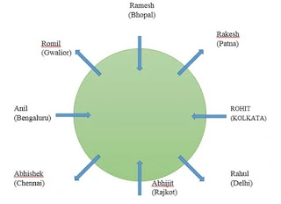

Slide 23

QUESTION 9
Eight persons L, M, N, O, P, Q, R, and S are sitting at a circular table facing away from the center. Each of them likes different banks viz. SBI, BOB, PNB, BOM, BOI, UBI, OBC, and CBI. All the information is not necessarily in the same order.
The one who likes PNB sits second to the left of the one who sits opposite to the one who likes CBI, who sits immediate right of L. One person sits between L and S.P sits third to the left of O, who likes SBI. P likes neither CBI nor PNB. O is not sitting adjacent to the one who likes CBI.Q sits immediate left of N, who likes UBI.
R sits second to the left of M. The one who likes BOB sits adjacent to the one who likes BOI, none of them sits adjacent to the one who likes SBI. S doesn’t like BOM. The one who likes BOB doesn’t sit adjacent to the one who likes OBC. The one who likes BOB or BOI doesn’t sit either adjacent or opposite to the one who likes UBI.

Slide 24
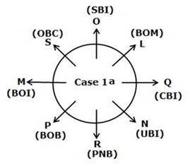
1) Which of the following statement/statements is/are true?
A) O sits third to the right of the one who likes UBI
B) The one who likes BOM sits second to the right of S
C) The one who likes BOB sits immediate left of the one who likes PNB
D) Both (b) and (c)
E) Both (a) and (b)
2) Which among the following doesn’t form a group?
A) M- BOB
B) R- UBI
C) S- BOI
D) Q- UBI
E) L- SBI
Notes:
Correct Option:
1)B
2)D

Slide 25
QUESTION 10
Representatives of eight different banks, viz A, B, C, D, E, F, G and H are sitting around a circular table, facing the center, but not necessarily in the same order. Each one of them is from a different bank, viz UCO Bank, Oriental Bank of Commerce, Bank of Maharashtra, Canara Bank, Syndicate Bank, Punjab National Bank, Bank of India and Dena Bank.
F sits second to the right of the representative of Bank of India is an immediate neighbor of the representative of Canara Bank.
Two person sit between the representative of Bank of India and B. C and E are immediate neighbors.
Neither C nor E is an immediate neighbor of either B or the representative of Canara Bank.
The representative of Bank of Maharashtra sits second to the right of D. D is the representative of neither Canara Bank nor Bank of India.
G and the representative of UCO Bank are immediate neighbors. B is not the representative of UCO Bank.
Only one person sits between C and the representative of Oriental Bank of Commerce.
H sits third to the left of the representative of Dena Bank.
The representative of Punjab National Bank sits second to the left of the representative of Syndicate Bank.

Slide 26
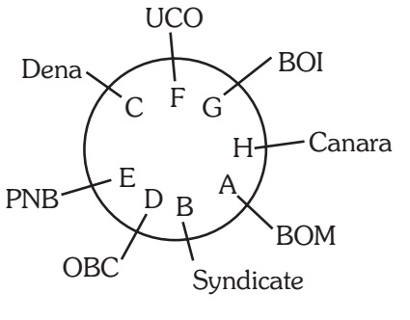
1Q.Who among the following sits exactly between B and the representative of Bank of India?
A) A and the representative of UCO Bank
B) F and G
C) H and the representative of Bank of Maharashtra
D) H and G
E) Representative of Syndicate Bank and Oriental Bank of Commerce
Notes:
Correct Option: C
H and the representative of Bank of Maharashtra

Slide 27
QUESTION 11
Eight persons - J, K, L, M, N, O, P, Q are sitting around a circular table facing the centre with equal distances between each other (but not necessarily in the same order). Each of them is also related to N in some way or the other. K sits third to the left of N. Only one person sits between N and Q. N's sister sits to the immediate right of Q. Only two people sit between N's sister and N's mother. J sits to the immediate right of N's mother. P sits to the immediate right of M. N's brother sits third to the right of P. N's wife sits second to the left of N's brother. Only three people sit between N's wife and L. N's son sits second to the right of N's father. Only two people sit between N's father and N's daughter.
1) How many people sit between N and K, when counted from the right of K ?
A) Five
B) Two
C) Four
D) Three
Notes:
Ans: b

Slide 28
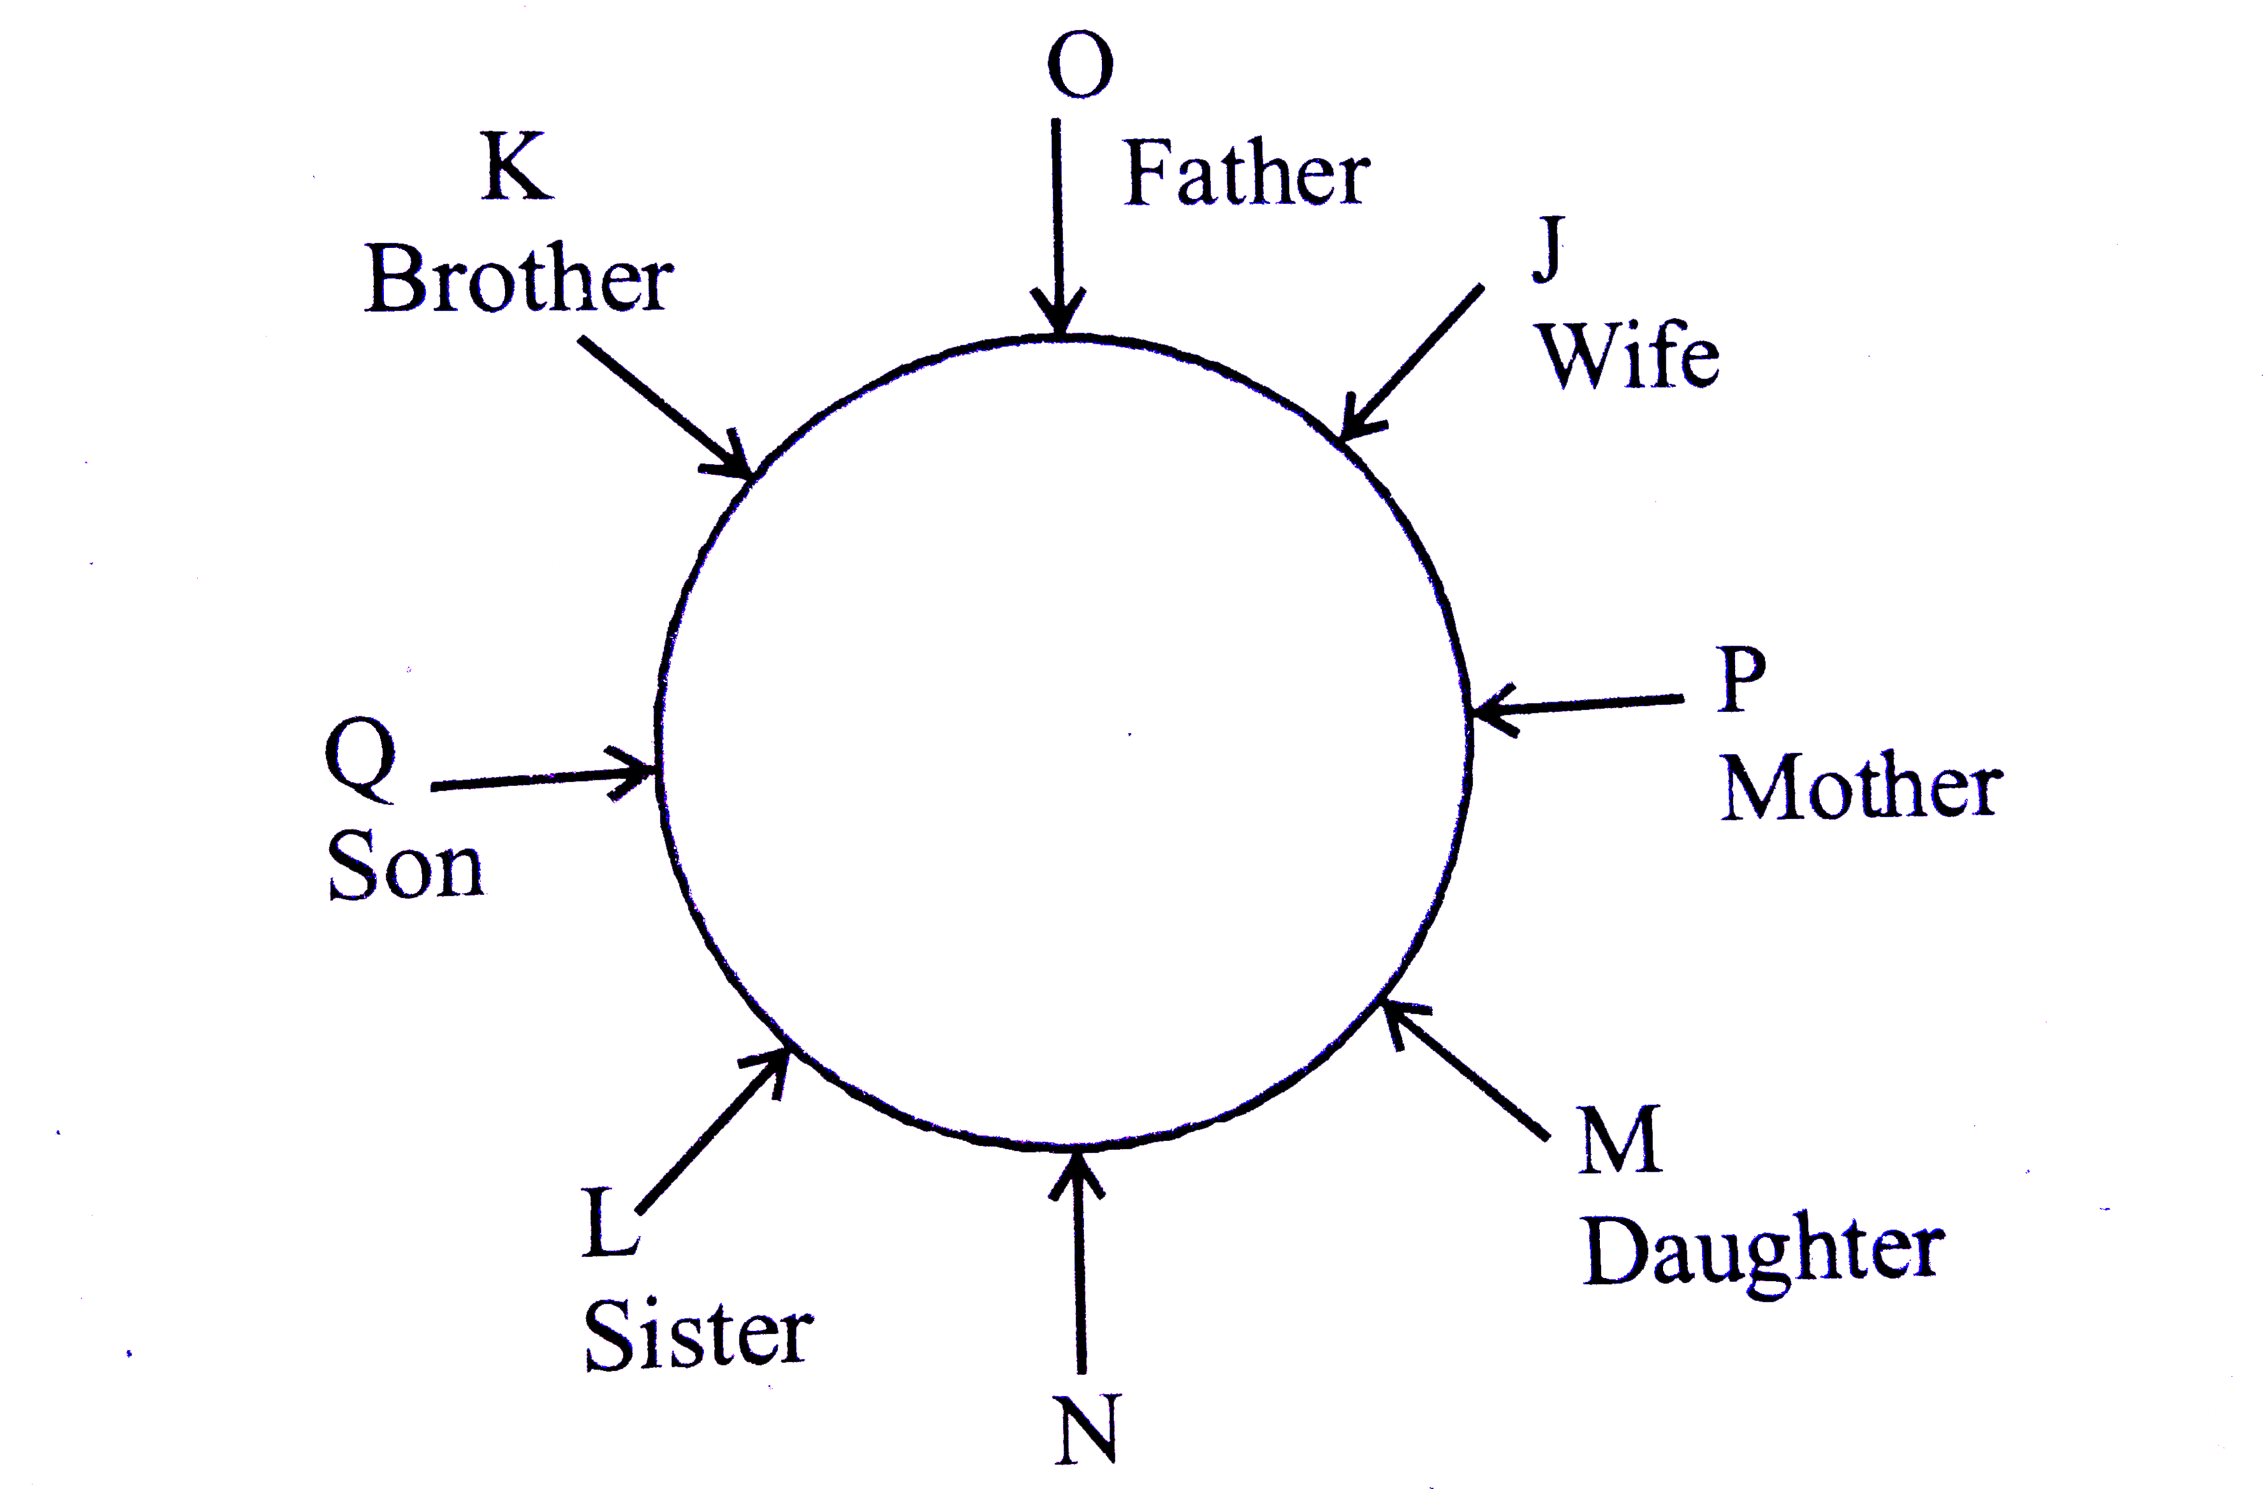

Slide 29
QUESTION 12
Eight friends P, Q, R, S, T, U, V and W are sitting in a circle not all are facing the center.
Q is sitting between V and S and facing center.
W is third to the left of Q and second to the right of P and facing like Q.
R is facing the direction of V and is sitting between P and V.
Q and T are not sitting opposite to each other. Neighbors of Q are facing the direction to opposite of that of Q.
W is sitting immediate right of T.

Slide 30
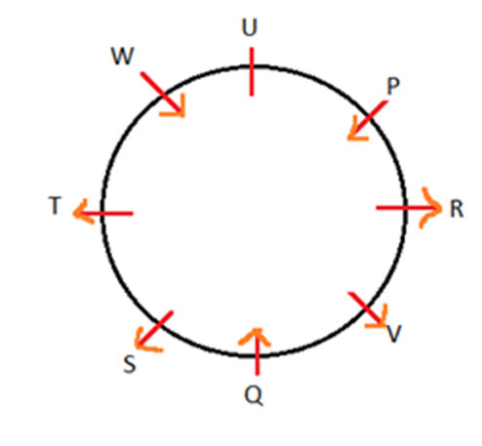
1Q. .Who are the neighbours of P ?
A. U,V
B. U,W
C. U,R
D. V,R
2Q. Who is immediate left of V
P
Q
R
S
Notes:
ANS: C , C

Slide 31
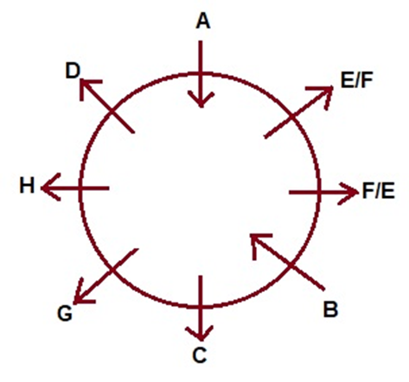
QUESTION 13
Eight people - A, B, C, D, E, F, G and H are sitting around a circular table.
A and B are facing towards the center while the other six people are facing away from the center.
A is sitting second to the right of H.
B sits third to the left of A.
D sits second to the right of G.
G is immediate neighbour of neither B nor A.
E and F are immediate neighbors and are facing outside.
1Q. What is the position of C with respect to D?
Third to the right
Third to the left
Fourth to the left
Fourth to the right
Second to the left
Notes:
ANS: B

Slide 32
QUESTION 14
Eight friends are sitting at an octagonal table. Each person is sitting in one corner facing the center. Mohan is sitting slant in front of Rahul. Rahul is to the right of Shekhar. Niraj is sitting beside Shekhar and in front of Rohit. Rohit is to the left of Vishal. Shivani is not to the right of Mohan but is in front of Puja.

Slide 33
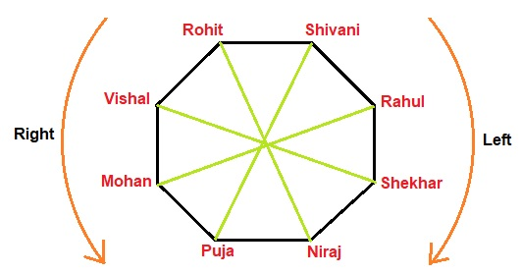
Find who is sitting to the left of Shivani?
Rahul
Rohit
Vishal
shekar
Notes:
Answer : a

Slide 34
QUESTION 15
Six People Aksar, Bashir, Chishti, Dullah, Eijaz and Faizal are seating on the ground in a hexagonal shape. All the sides of the hexagon, so formed are of same length.
Aksar is not adjacent to Bashir or Chishti.
Dullah is not adjacent to Chishti or Eijaz.
Bashir and Chishti are adjacent to each other.
Faizal is in the middle of Dullah and Chishti.

Slide 35
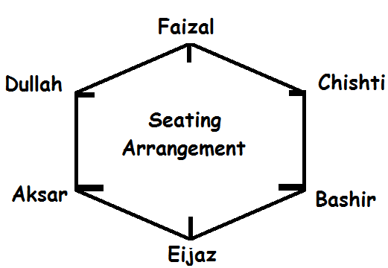
Which of the following is not a correct neighbor pair?
a) Aksar and Faizal
b) Dullah and Faizal
c) Bashir and Eijaz
d) Chishti and Faizal
e) None of The Above
Q2. Who is at the same distance from as Dullah as Eijaz is from Dullah?
a) Faizal
b) Bashir
c) Chishti
d) Aksar
e) None of The Above
Notes:
Answer 1 (Option A)
Answer 2 (Option C)

Slide 36
QUESTION 16
There are six persons P, Q, R, S, T and U are sitting in a triangular shaped seating arrangement. Three persons are sitting at the corner of the triangle facing outside. Three Persons are sitting at the sides of the triangle facing inside.
The persons are in different occupations lawyer, politician, doctor, teacher, astrologer and scientist not necessarily in the same order. Two persons sit between scientist and politician. One person sits between teacher and lawyer. Astrologer sits second to the right of the politician. U sits second to the right of the astrologer. U and T sits adjacent to each other. S sits second to the left of T. Q sits second to the right of politician. Teacher sits immediate left of politician. Lawyer sits at one of the corners of the triangle. P sits to the immediate left of T. S is not a doctor.

Slide 37
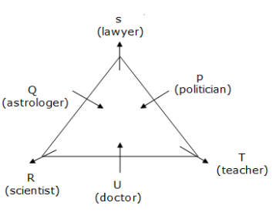
1)Who among the following sits to the immediate right of teacher?
a) Doctor b) Lawyer c) Politician d) Astrologer
e) None of these
2) Who among the following sits opposite to doctor?
P b) Q c) S d) T e) None of these
3) What is the occupation of R?
a) Lawyer b) Politician c) Scientist d) Teacher
e) None of these
Notes:
Ans: a
c
c

Slide 38
QUESTION 17
In the Chief Minister Meeting, six Chief Ministers namely- P, Q, R, S, T and U are sitting at the corners of the hexagonal shaped table facing the centre. They belong to a different state- Tamil Nadu, Kerala, Maharashtra, Telangana, Andhra Pradesh, and Karnataka. All the information is not necessarily in the same order.
Q is the chief minister of Karnataka sits immediately to the left of the one who faces P. Only one person sits between T and the one who is the chief minister of Telangana. The chief minister of Tamil Nadu sits adjacent to P. R sits immediate right of T who faces the Chief Minister of Andhra Pradesh. R is not the CM of tamilnadu. U neither belongs to Kerala nor Tamil Nadu. T is not the Chief Minister of Maharashtra. S sits adjacent to either P or R but not adjacent to both.

Slide 39
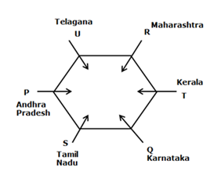
1) Four of the following five are alike in a certain way and form a group. Who among the following person does not belong to the group?
A) UR
B) QS
C) PU
D) PQ
E) RT
2) Who among the following person is the chief minister of Tamil Nadu?
A) T
B) The one who sits immediate left of U
C) R
D) The one who sits immediate right of P
E) The one who sits second to the right of Q
Notes:
1) Answer: D
2) Answer: D

Slide 40
QUESTION 18
Ten persons A,C,D,E,G,I,M,N,O and P sit on the corners and edges of a pentagon table. All of them are facing outside the table. All of them teach different subjects i.e. English, History, Maths, physics, chemistry, finance, marketing, Hindi, biology and sociology but not necessarily in the same order. Person whose name starts with vowel doesn’t sit adjacent to each other.
N sits 3rd to the left of one who teaches history. Both the immediate neighbours of G sit on the corner of the table and one of them teaches finance. P teaches chemistry. Three persons sit between G and D (either from left or right side).person who teaches biology sits 2nd to the left of N. I sits immediate right of D. O sit on the corner and is two places away from the one who teaches biology. Both A and P are immediate neighbours of the person who teaches sociology. Neither A nor P teaches history. C teaches marketing and sits 3rd to the left of one who teaches Hindi. person who teaches Maths and physics sit adjacent to each other. M is not immediate neighbour of the person who teaches physics. G is not an immediate neighbour of O .The one who teaches Hindi sits immediate left of O.

Slide 41
Q1) who teaches history and physics?
D & G
N & C
G & D
C & N
Q2) what N and O teaches?
Sociology & maths
Finance & English
Hindi & Biology
Chemistry & marketing
Notes:
1) Answer : c
2) Answer : a

Slide 43
QUESTION 19
Twelve people were seated around a triangular table facing inwards such that three people were seated on each edge and one person on each corner.
Only five people sit between J and I and neither J nor I sits at corners. E who sits at one of the corner is third to the right of I. F, who is second to left of I, is immediate left of D. Only two people sit between F and G, who is immediate neighbor of J. A, B and C were seated in the middle of each edge. Two people sit between K and A, who doesn’t sit near I. E is an immediate neighbor to both L and H, who is an immediate neighbor to B.

Slide 44
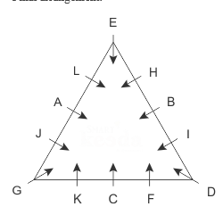
Q1) Find the odd one out.
a) A, G
b) D, B
c) C, D
d) H, I
e) E, B
Q2) How many people sit between G and L if counted from left of G?
a) None
b) 1
c) 2
d) 3
e) 4
Notes:
Answer: D
Answer : C

Slide 45
QUESTION 20
Eight persons are sitting around a square table such that two persons sit on each side of the table (facing center). Each of them either have 9 or 10 toffees.
B who has 10 toffees sits 4th left to A. None of the persons having 9 toffees sit together. Not more than one person sit between H and E.
Not less than three persons have same number of toffees. F faces C and both have same toffees as A.
Only one person sit between F and G. G is not neighbor of B. D has odd number of toffees and sits 2nd to the right of A.
E is not 3rd right to A. Two persons sit between B and H.

Slide 46
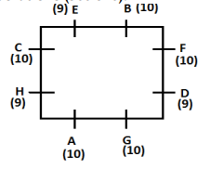
Who sit 4th left to the one who is immediate right to B?
(a) E (b) F (c) C (d) B (e) None of these
2) How many persons sit between D and E, when counted from right of D?
(a) Two (b) One (c) Three (d) Four (e) None of these
Notes:
1) Answer: e
2) answer: a

Slide 47
THANK YOU
Notes:
Thank you slide

